Slide 1
SLGAN: Style-and Latent-guided Generative Adversarial Network for Desirable Makeup Transfer and Removal (ACM 2018)
Jongwook Si (M. S Course)

Slide 2
Abstract
To apply makeup to photos of the human face:
Facial component (얼굴 구성요소)
Interactive color adjustment (상호작용적인 색상 조정)
Makeup Variations (메이크업 변형)
Robustness to poses and expressions (자세와 표현의 견고함)
Use of multiple reference images (멀티 레퍼런스 이미지 사용)
This paper closes the gap with an innovative style and latent-guided GAN
They provide a novel, perceptual makeup loss and a style-invariant decoder
overview

Slide 3
Introduction
overview
Several studies of makeup transfer(MT) and removal(MR) have been proposed
However, extant works have never striven to satisfy all five of the mentioned feature variables.
BeautyGAN and PairedCycleGAN could not adjust the generated results
In this paper, to adequately address all five features

Slide 4
Introduction
Major contributions of this paper
A novel SLGAN framework (First style and latent-guided framework)
Style-invariant decoder assists the generator to translate images that preserve the identity of the source
A novel perceptual makeup loss that enables the generator to perform a high quality translation
enabled the users to find the best makeup style by adjusting latent and style codes

Slide 5
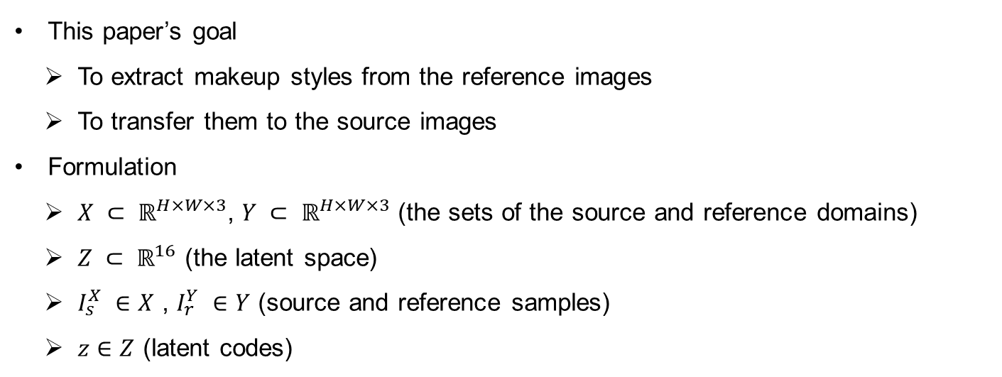
SLGAN
Formulation
This paper’s goal
To extract makeup styles from the reference images
To transfer them to the source images
Formulation
$X ⊂ ℝ^{H×W×3}$, $Y ⊂ ℝ^{H×W×3}$ (the sets of the source and reference domains)
$Z ⊂ ℝ^{16}$ (the latent space)
$I_{s}^{X} ∈X$ , $I_{r}^{Y} ∈Y$ (source and reference samples)
$z∈Z$ (latent codes)

Slide 6
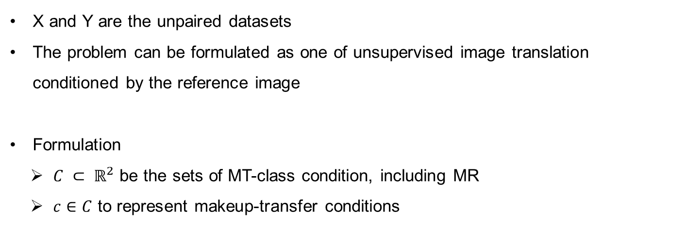
SLGAN
Formulation
X and Y are the unpaired datasets
The problem can be formulated as one of unsupervised image translation conditioned by the reference image
Formulation
$C ⊂ ℝ^{2}$ be the sets of MT-class condition, including MR
$c∈C$ to represent makeup-transfer conditions

Slide 7
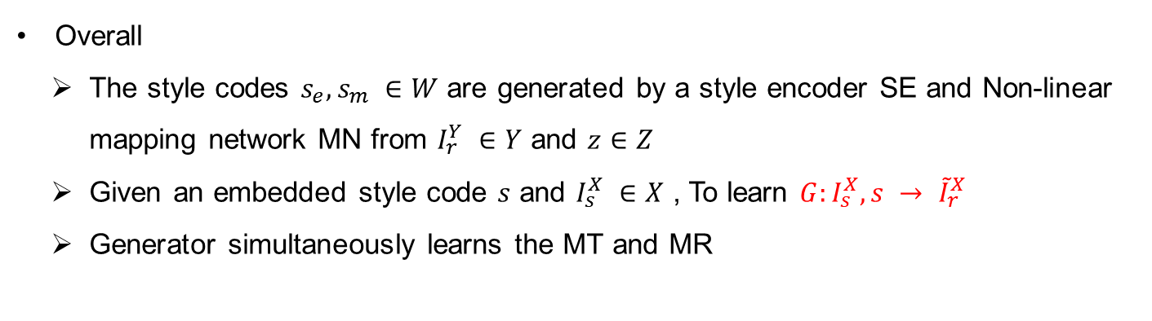
SLGAN
Network Architecture
Overall
The style codes $s_{e}, s_{m} ∈W$ are generated by a style encoder SE and Non-linear mapping network MN from $I_{r}^{Y} ∈Y$ and $z∈Z$
Given an embedded style code $s$ and $I_{s}^{X} ∈X$ , To learn $G:I_{s}^{X}, s → {\tilde{I}}_{r}^{X}$
Generator simultaneously learns the MT and MR

Slide 8
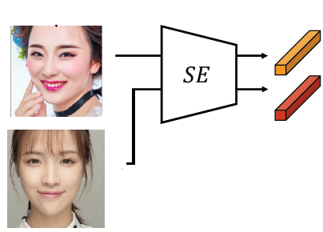
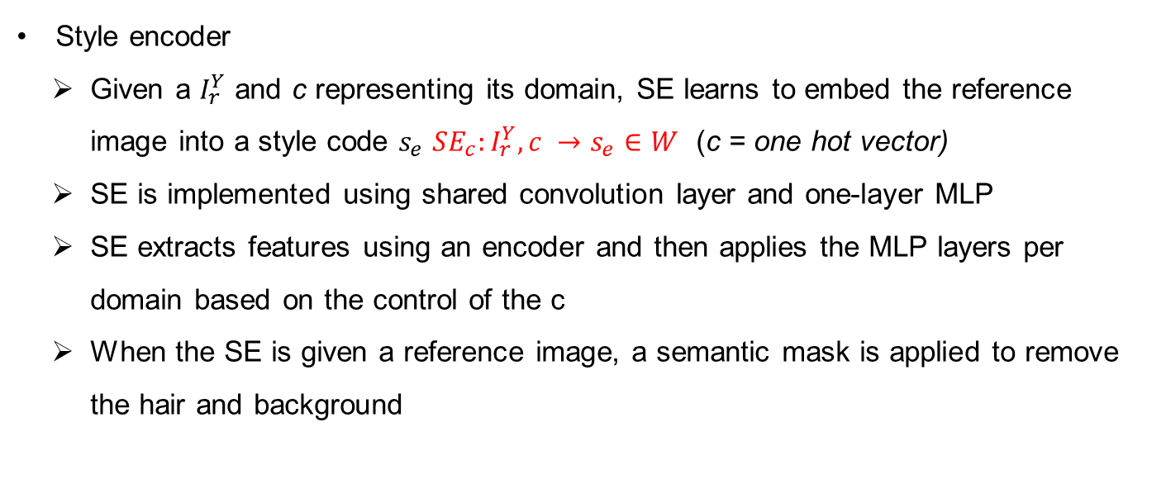
SLGAN
Network Architecture
Style encoder
Given a $I_{r}^{Y}$ and c representing its domain, SE learns to embed the reference image into a style code $s_{e}$ $SE_{c}:I_{r}^{Y}, c →s_{e}∈W$ (c = one hot vector)
SE is implemented using shared convolution layer and one-layer MLP
SE extracts features using an encoder and then applies the MLP layers per domain based on the control of the c
When the SE is given a reference image, a semantic mask is applied to remove the hair and background

Slide 9
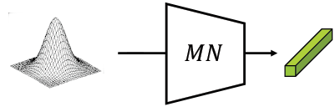
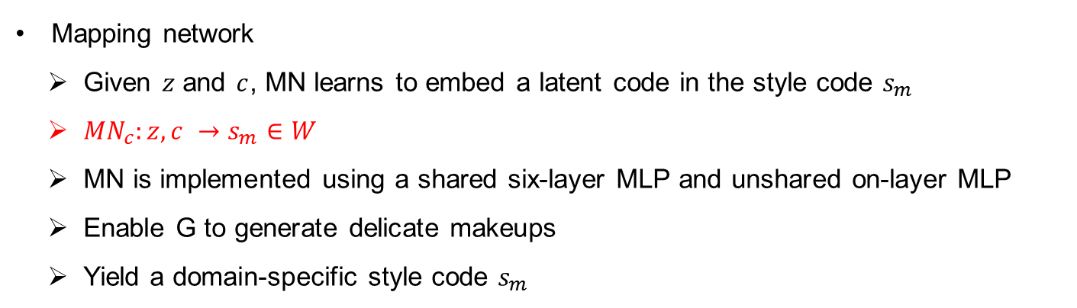
SLGAN
Network Architecture
Mapping network
Given $z$ and $c$, MN learns to embed a latent code in the style code $s_{m}$
${MN}_{c}:z, c →s_{m}∈W$
MN is implemented using a shared six-layer MLP and unshared on-layer MLP
Enable G to generate delicate makeups
Yield a domain-specific style code $s_{m}$
Notes:
Delicate : 섬세한

Slide 10
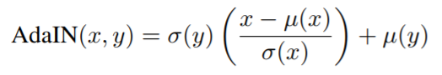
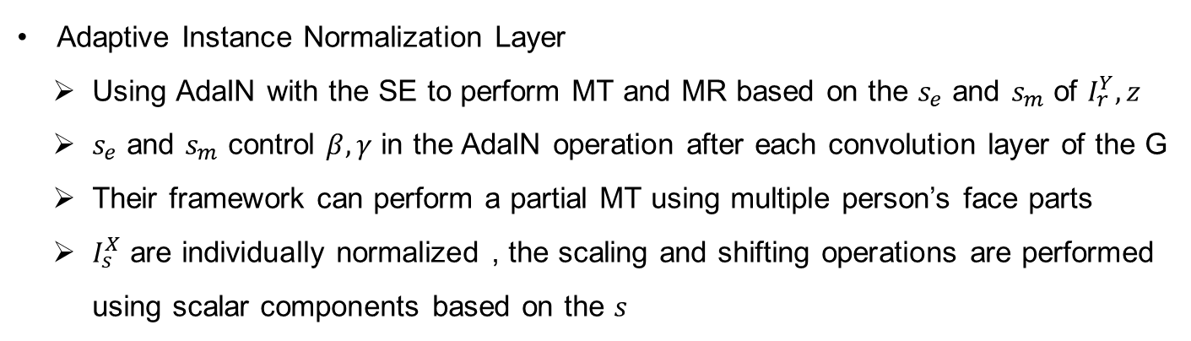
SLGAN
Network Architecture
Adaptive Instance Normalization Layer
Using AdaIN with the SE to perform MT and MR based on the $s_{e}$ and $s_{m}$ of $I_{r}^{Y}, z$
$s_{e}$ and $s_{m}$ control $β, γ$ in the AdaIN operation after each convolution layer of the G
Their framework can perform a partial MT using multiple person’s face parts
$I_{s}^{X}$ are individually normalized , the scaling and shifting operations are performed using scalar components based on the $s$

Slide 11
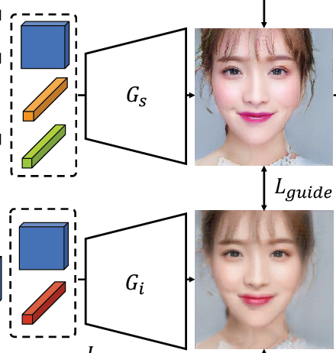
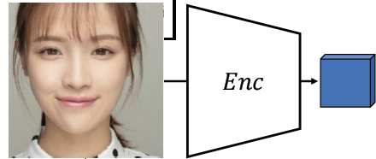
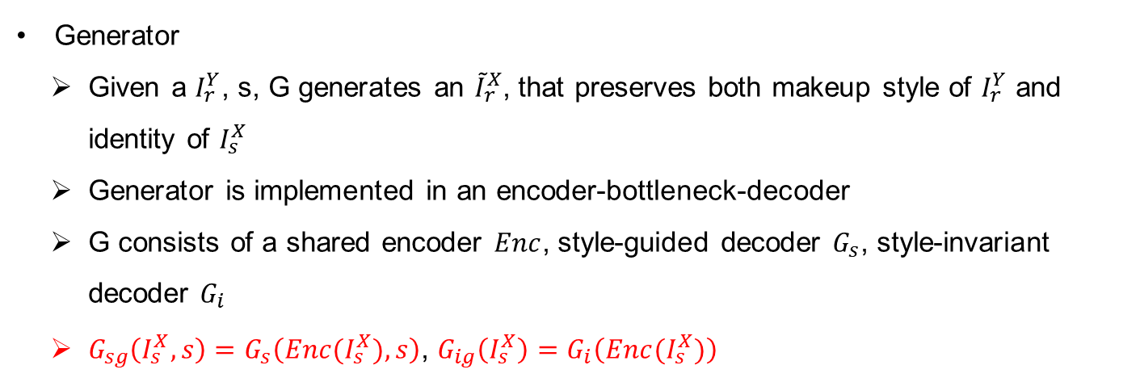
SLGAN
Network Architecture
Generator
Given a $I_{r}^{Y}$, s, G generates an ${\tilde{I}}_{r}^{X}$, that preserves both makeup style of $I_{r}^{Y}$ and identity of $I_{s}^{X}$
Generator is implemented in an encoder-bottleneck-decoder
G consists of a shared encoder $Enc$, style-guided decoder $G_{s}$, style-invariant decoder $G_{i}$
$G_{sg}\left(I_{s}^{X}, s\right)=G_{s}\left(Enc(I_{s}^{X}), s\right)$, $G_{ig}\left(I_{s}^{X}\right)=G_{i}\left(Enc(I_{s}^{X})\right)$

Slide 12
SLGAN
Network Architecture
Discriminator
D has the same structure as the SE
Multi-task discriminator has multiple linear output branches
Each branch learns domain-specific features

Slide 13
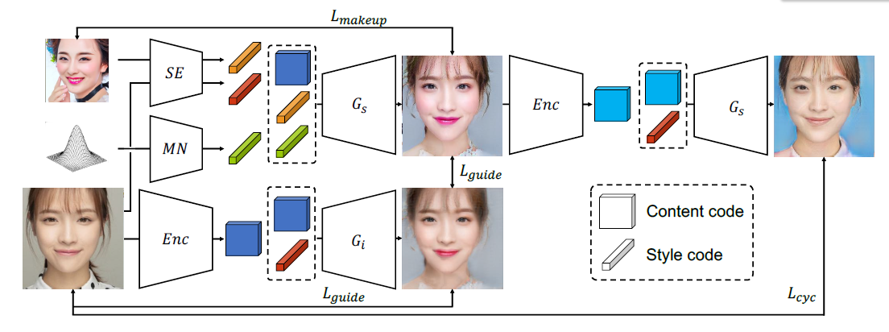
SLGAN
Network Architecture

Slide 14
SLGAN
Style-invariant Decoder
What is Identity-shift problem?
Generator can’t preserve the identity of the source image when the global style of the reference image is embedded in the style code
To overcome this problem…
Style-invariant decoder generates images from the shared feature without the style code, which is extracted by a shared encoder
Is only used for training, not for testing

Slide 15
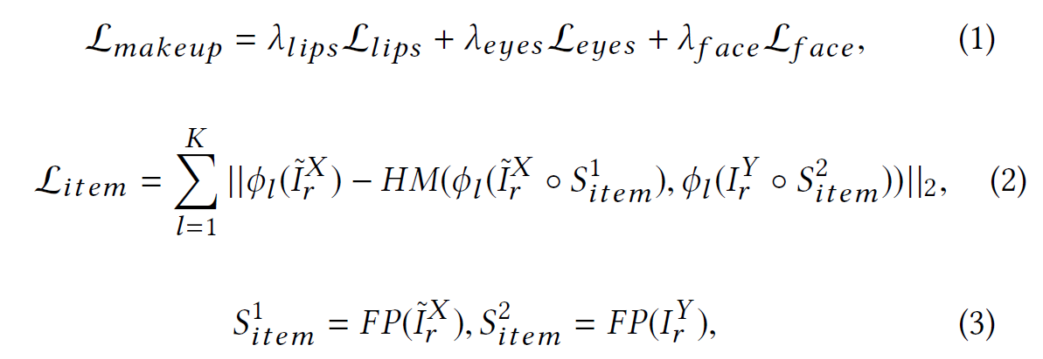
SLGAN
Perceptual Makeup Loss
They proposed a new histogram-matching strategy and perceptual makeup loss
Defined as :
Item = {lips, eyes, face}
FP = Face parsing algorithm
HM = Histogram matching

Slide 16
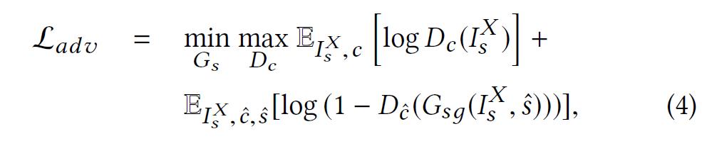
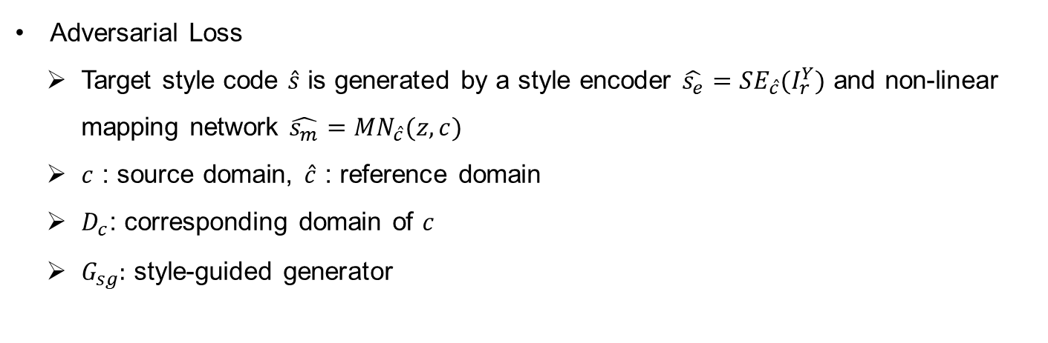
SLGAN
Other Objectives
Adversarial Loss
Target style code $\hat{s}$ is generated by a style encoder $\hat{s_{e}}=SE_{\hat{c}}(I_{r}^{Y})$ and non-linear mapping network $\hat{s_{m}}={MN}_{\hat{c}}(z, c)$
$c$ : source domain, $\hat{c}$ : reference domain
$D_{c}$: corresponding domain of $c$
$G_{sg}:$ style-guided generator

Slide 17
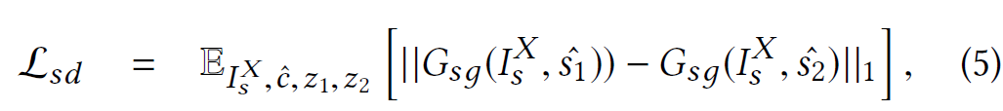
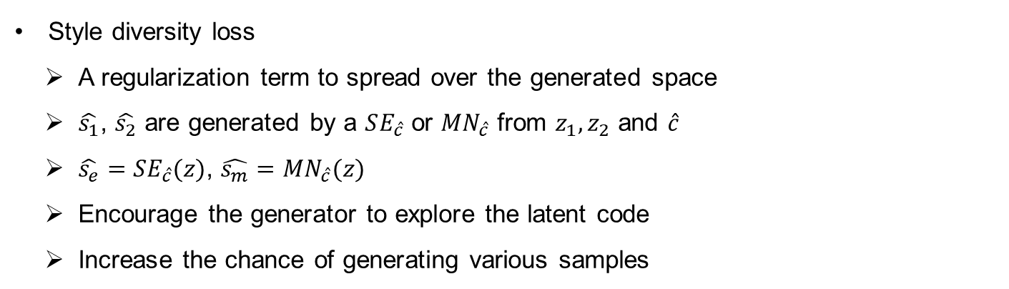
SLGAN
Other Objectives
Style diversity loss
A regularization term to spread over the generated space
$\hat{s_{1}}$, $\hat{s_{2}}$ are generated by a $SE_{\hat{c}}$ or ${MN}_{\hat{c}}$ from $z_{1}, z_{2}$ and $\hat{c}$
$\hat{s_{e}}=SE_{\hat{c}}(z)$, $\hat{s_{m}}={MN}_{\hat{c}}(z)$
Encourage the generator to explore the latent code
Increase the chance of generating various samples

Slide 18
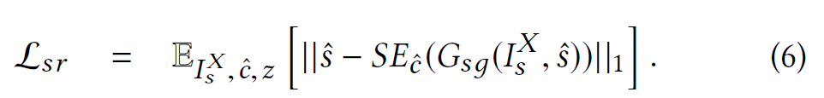
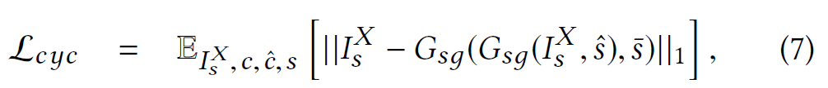
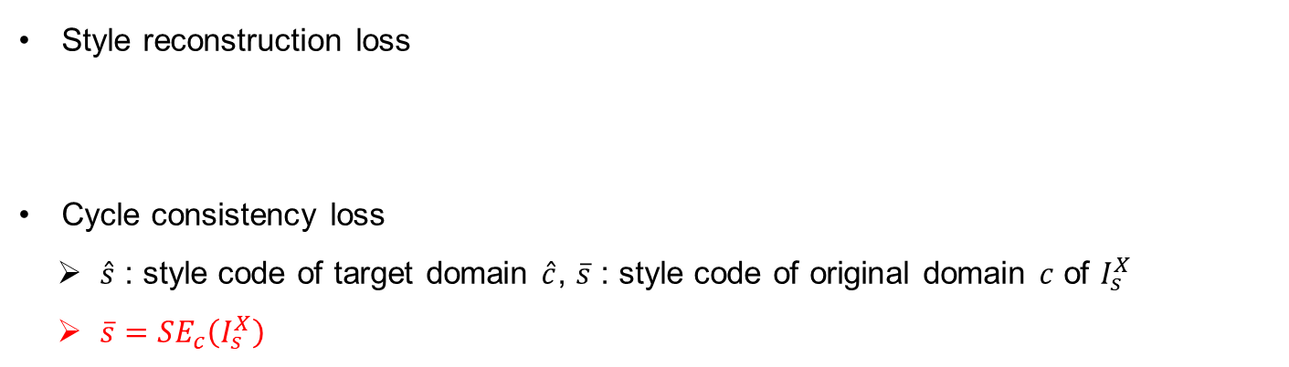
SLGAN
Other Objectives
Style reconstruction loss
Cycle consistency loss
$\hat{s}$ : style code of target domain $\hat{c}$, $\overline{s}$ : style code of original domain $c$ of $I_{s}^{X}$
${\overline{s}=SE}_{c}\left(I_{s}^{X}\right)$

Slide 19
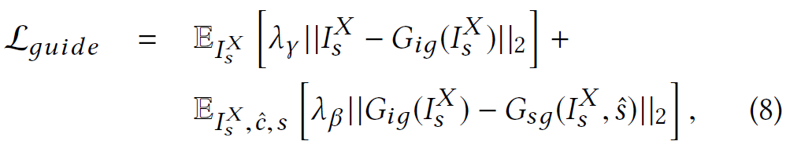
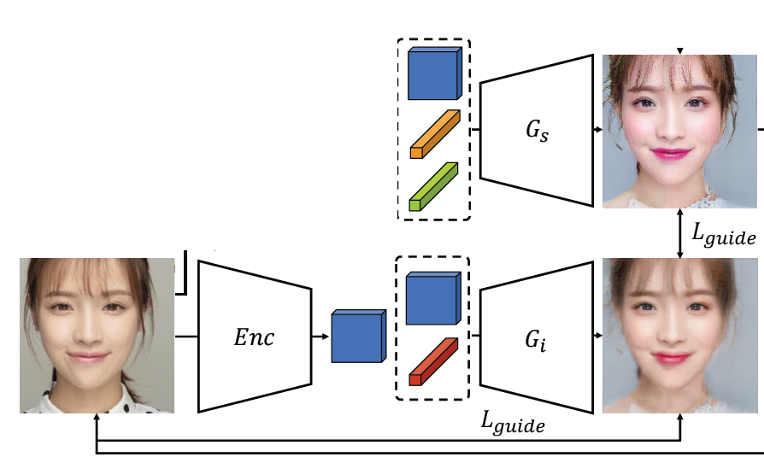
SLGAN
Other Objectives
Style –invariant guide loss
To encourage the generated image to naturally apply the style of the reference
To maintain the content of the source image

Slide 20
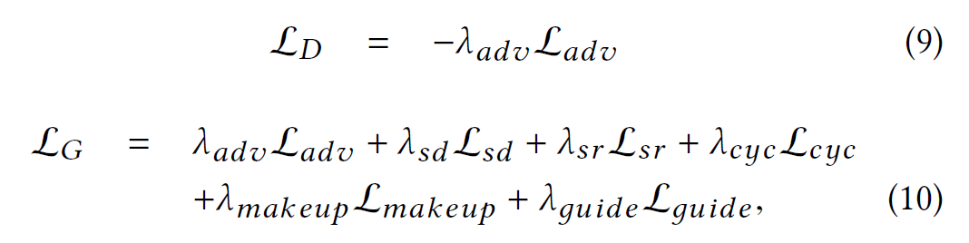
SLGAN
Other Objectives
Total Loss

Slide 21
Experiments
Implementation Details
Dataset
Use the Makeup Transfer dataset (MT)
The dataset contains 3,834 facial images with a resolution of 256x256
1,115 non-makeup, 2,719 makeup
Included various makeup style (smokey-eyes, Korean, japaneese, retro etc.)
Test set consists of 1– and 250 non-makeup and makeup images

Slide 22
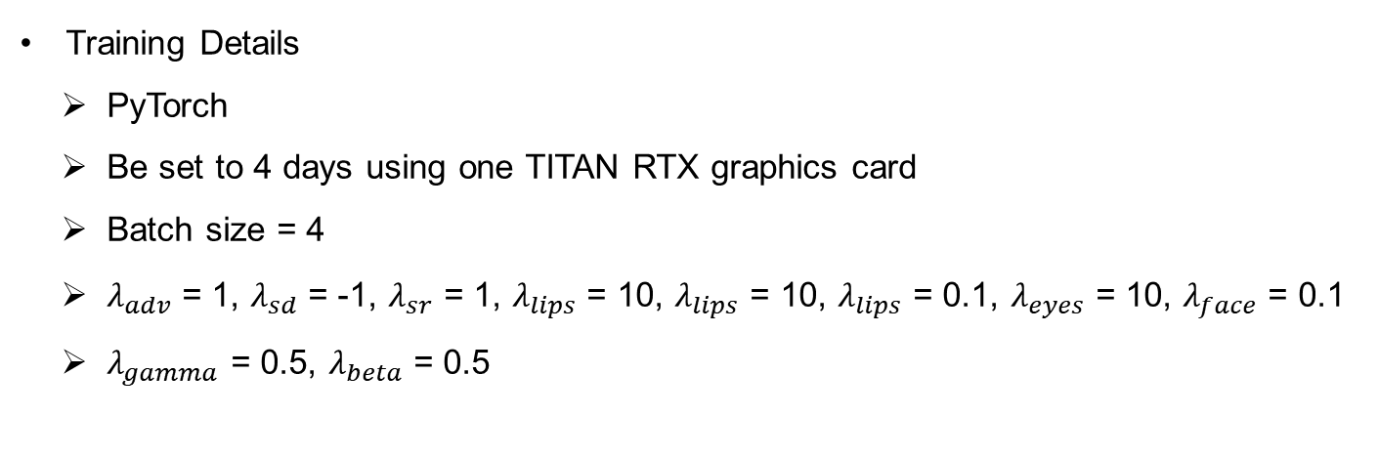
Experiments
Implementation Details
Training Details
PyTorch
Be set to 4 days using one TITAN RTX graphics card
Batch size = 4
$λ_{adv}$ = 1, $λ_{sd}$ = -1, $λ_{sr}$ = 1, $λ_{lips}$ = 10, $λ_{lips}$ = 10, $λ_{lips}$ = 0.1, $λ_{eyes}$ = 10, $λ_{face}$ = 0.1
$λ_{gamma}$ = 0.5, $λ_{beta}$ = 0.5

Slide 23
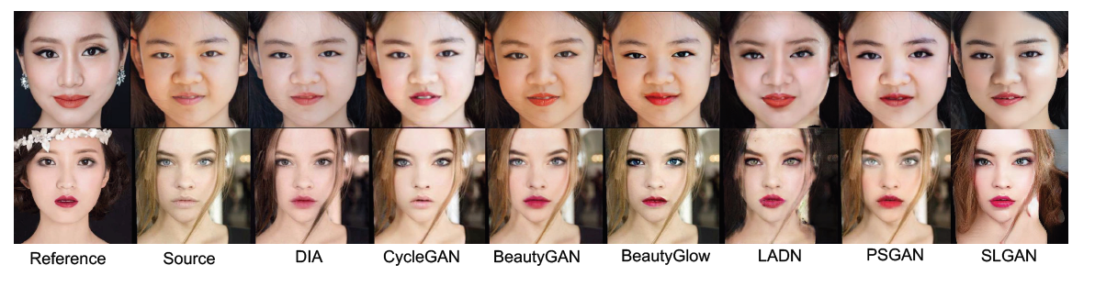
Experiments
Makeup Transfer Results
Qualitative Comparison

Slide 24
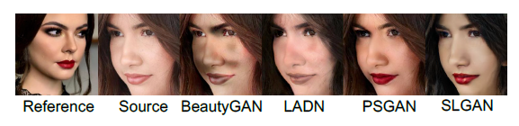
Experiments
Makeup Transfer Results
Qualitative Comparison

Slide 25
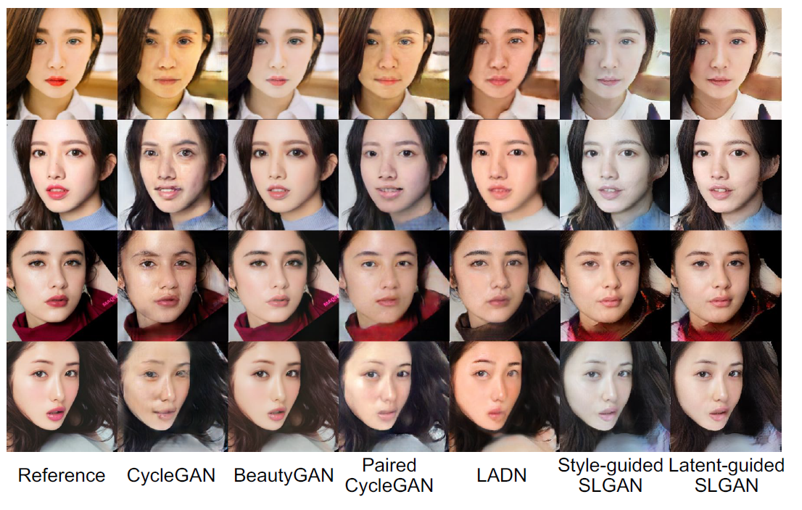
Experiments
Makeup Removal Results
Qualitative Comparison

Slide 26
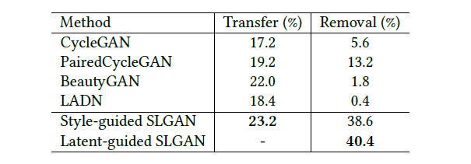
Experiments
Makeup Removal Results
AMT in which 10 people participated
Randomly selected 20 source and 20 reference images from the test set and generated images for all combinations
From the generated results, they randomly selected 50 images per method
Latent-guided SLGAN could not be given reference images

Slide 27
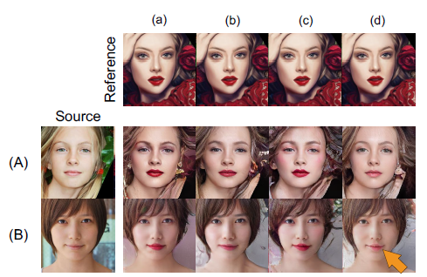
Experiments
Ablation Study
Perceptual Makeup Loss
(a) a style encoder
(b) VGG16 for feature extraction
(c) makeup loss[24] instead of PM Loss
(d) no makeup losses

Slide 28
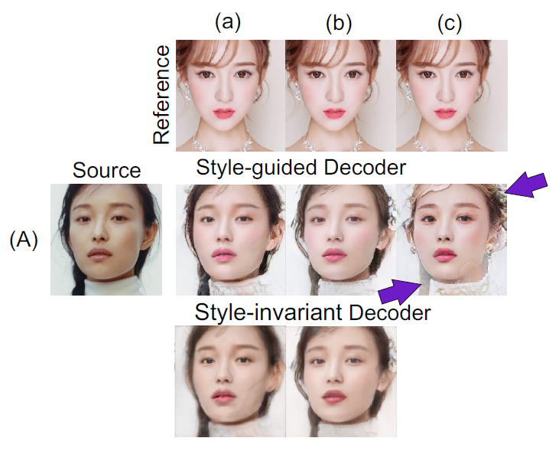
Experiments
Ablation Study
Style-invariant Decoder
(a) L2 norm in Eq. (8)
(b) L1 norm in Eq. (8)
(c) No style-invariant decoder
(b) And (c) : artifacts in the hair and background

Slide 29
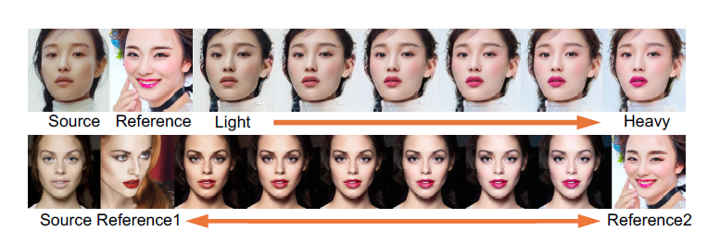
Experiments
Interpolation of Style Codes
It is important to make color adjustments to provide the best makeup suggestion to the user

Slide 30
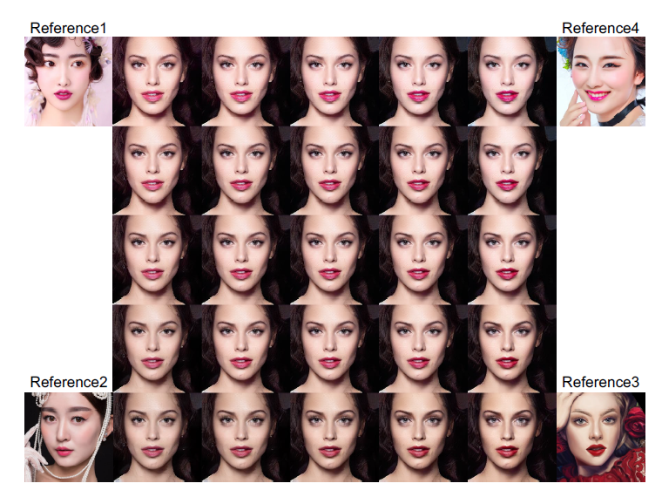
Experiments
Interpolation of Style Codes
SLGAN can interpolated a single source image from multiple references!!!

